Slide 1



STOCK TRADING & INVESTMENT PERFORMANCE ANALYTICS SYSTEM
~ Presented by:
S Charishma

Slide 2

Business Context
Financial traders and investment firms work with large volumes of daily stock market data, including prices, trades, and benchmarks.
Traditional manual analysis methods are time-consuming, error-prone, and not scalable.
Due to the lack of automation and centralized analytics, it becomes difficult to:
Track portfolio performance
Analyze market trends and risk
Compare returns against benchmarks
This project focuses on building an automated and scalable analytics system that processes stock data efficiently and delivers actionable insights through dashboards.

Slide 3




Problem Statement
Traders and investment firms rely on stock market data to make critical decisions, but existing analysis approaches are often manual, fragmented, and difficult to scale.
There is no unified system to:
Process large volumes of stock data efficiently
Track portfolio performance over time
Analyze risk, volatility, and sector trends
Compare portfolio returns against market benchmarks
As a result, decision-making becomes slower and less reliable.

Slide 4

The proposed solution is an end-to-end automated stock analytics system that processes market and portfolio data efficiently.
The system:
Uses a Bronze–Silver–Gold architecture for structured data processing
Automates data workflows using Apache Airflow
Performs large-scale analytics using Databricks and PySpark
Generates actionable insights through Power BI dashboards
This approach ensures scalability, accuracy, and timely insights for better investment decision-making.
Proposed Solution

Slide 5
Project Objectives
The main objectives of this project are to:
Automate stock market data ingestion and processing
Design a Bronze–Silver–Gold data architecture
Analyze portfolio performance, returns, and risk
Compare portfolio performance with market benchmarks
Orchestrate workflows using Apache Airflow
Visualize insights using Power BI dashboards

Slide 6
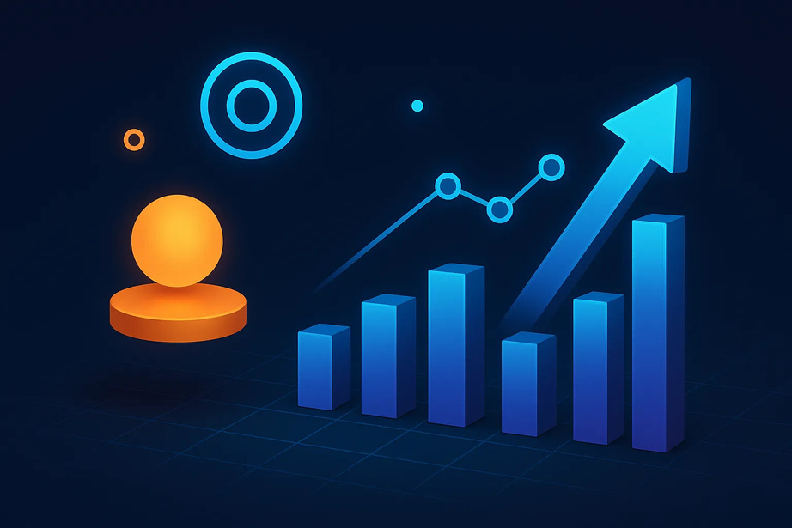
DataSet Overview
The project uses simulated but realistic stock market datasets to represent real-world trading scenarios.
The data covers multiple aspects of market and portfolio analysis, including:
Stock Price Data
Open, High, Low, Close, Volume
Portfolio Transaction Data
Buy and Sell trades with quantity and price
Company Sector Information
Mapping of stocks to industry sectors
Benchmark Index Data
Market index values for performance comparison

Slide 7

Technology Stack
The project uses industry-standard tools for data engineering, analytics, and visualization:
Programming & Data Processing
Python, Pandas, PySpark
Big Data & Storage
Databricks
Delta Lake
Workflow Orchestration
Apache Airflow (Dockerized)
Visualization & Reporting
Power BI
Version Control
Git

Slide 8
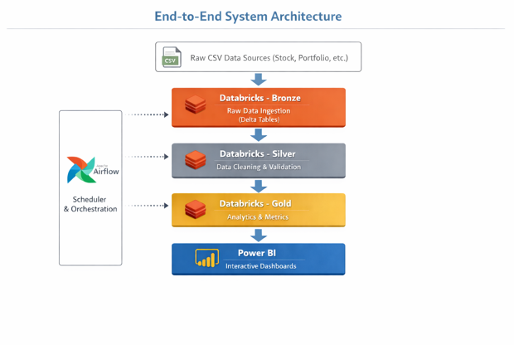
System Architecture
The system follows a layered data architecture to ensure scalability, reliability, and clear separation of responsibilities.
Raw data is ingested from CSV files into the Bronze layer
Data is cleaned, validated, and standardized in the Silver layer
Business metrics and analytics are generated in the Gold layer
Apache Airflow orchestrates the entire pipeline automatically
Power BI consumes Gold tables to deliver actionable insights

Slide 9
IMPLEMENTATION

Slide 10
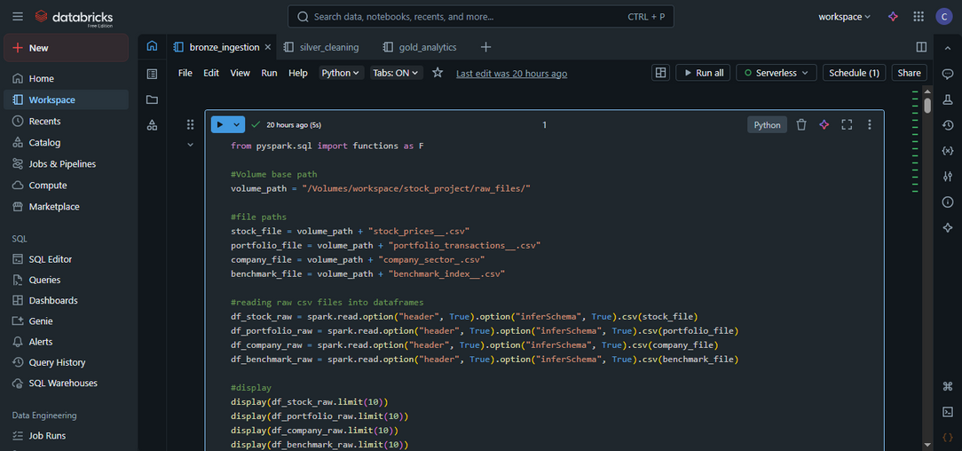
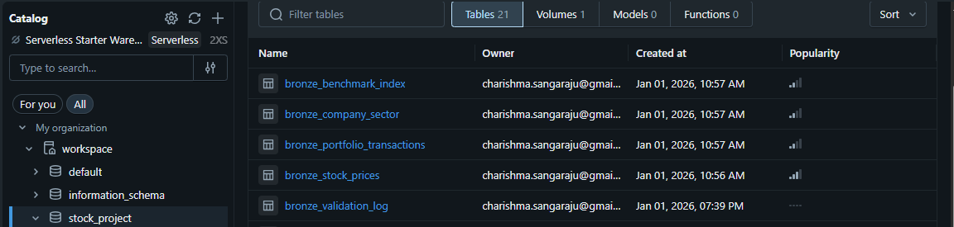
Bronze Layer- Raw Data Ingestion
Ingests raw CSV files from the source folder
Stores data without any transformation in Delta tables
Preserves original schema and values for traceability
Performs basic data inspection (row counts, null checks)
Creates validation logs for monitoring data quality
Serves as the foundation for all downstream processing
Key Output Tables
bronze_stock_prices
bronze_portfolio_transactions
bronze_company_sector
bronze_benchmark_index
bronze_validation_log

Slide 11
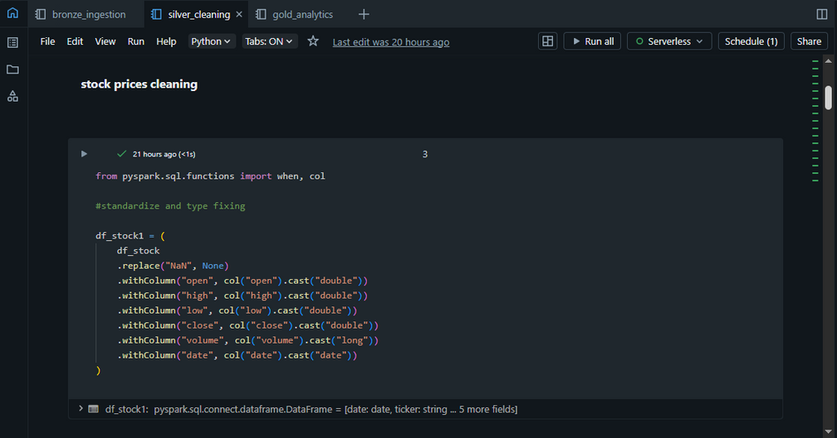
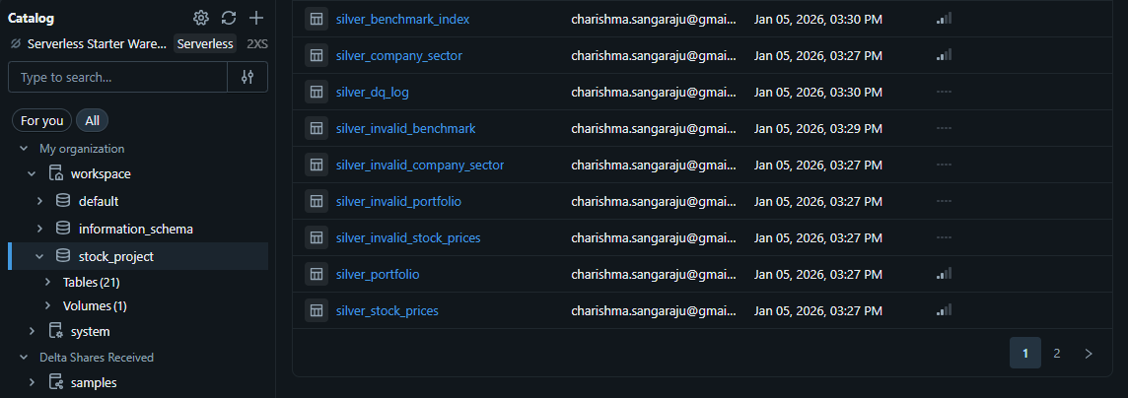
Silver Layer- Data Cleaning & Standardization
Cleans and standardizes data from the Bronze layer
Fixes data types (dates, prices, quantities, volume)
Handles nulls, invalid values, and business rule violations
Corrects misspellings (e.g., actions, sectors)
Separates valid and invalid records for auditing
Ensures only high-quality, analytics-ready data moves forward
Key Cleaning Rules
Removed negative or zero prices and quantities
Validated OHLC price consistency
Standardized BUY / SELL actions
Key Output Tables
silver_stock_prices
silver_portfolio
silver_company_sector
silver_benchmark_index
silver_invalid_* tables
silver_dq_log

Slide 12
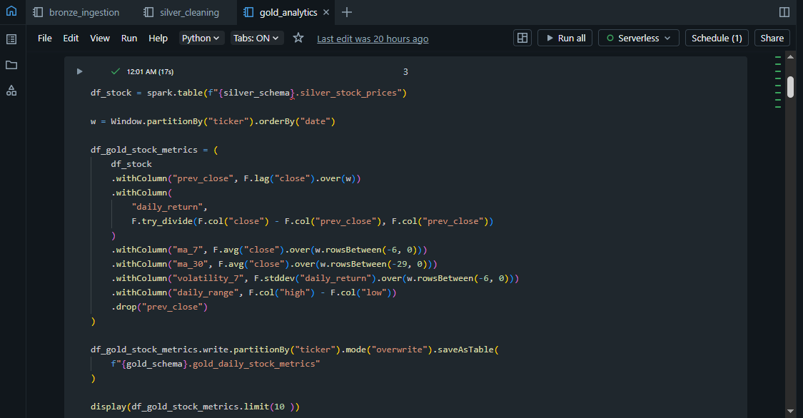
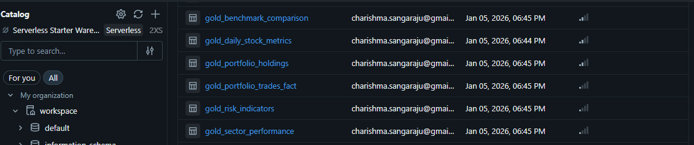
Gold Layer - Business Metrics & Analytics
Transforms cleaned Silver data into business-ready analytical tables
Calculates portfolio performance, returns, risk, and trends
Designed specifically for Power BI reporting & decision-making
Aggregations are optimized for fast querying and visualization
Key Metrics Created
Daily stock returns and moving averages (7D, 30D)
Portfolio holdings and market value over time
Trade-level analytics (BUY vs SELL, trade value)
Benchmark vs portfolio performance comparison
Risk indicators (volatility, downside deviation, Sharpe ratio)
Sector-level performance and volatility
Key Gold Tables
gold_daily_stock_metrics
gold_portfolio_holdings
gold_portfolio_trades_fact
gold_sector_performance
gold_benchmark_comparison
gold_risk_indicators

Slide 13
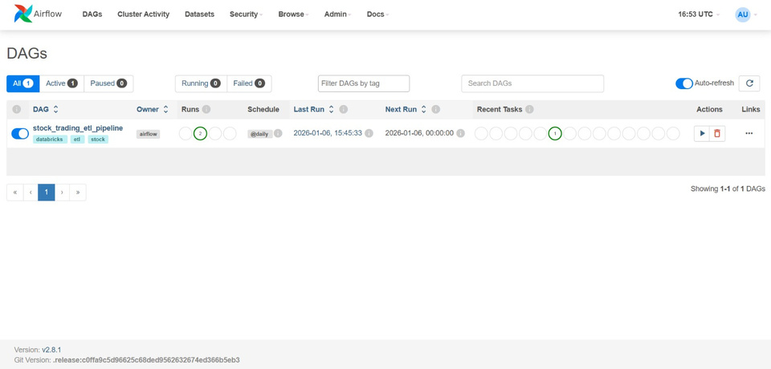
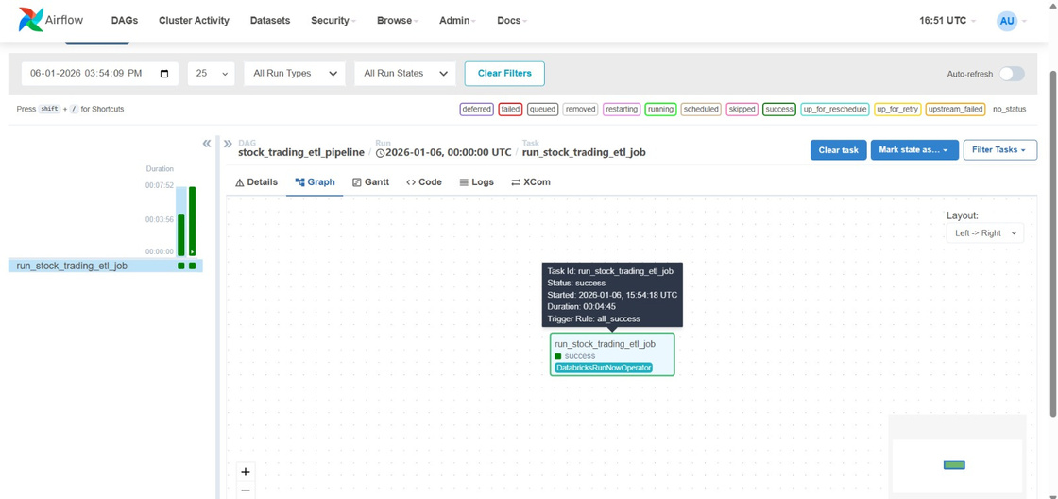
Apache Airflow
Apache Airflow is used to orchestrate the end-to-end ETL pipeline
Airflow triggers a single Databricks ETL job
The Databricks job internally contains three dependent tasks:
Bronze Task → Silver Task → Gold Task
Databricks manages task-level dependencies
Airflow handles:
Scheduling (daily execution)
Retries and failure handling
Centralized monitoring and logging
Airflow is deployed using Docker for a production-like setup
Key Benefit
Eliminates manual execution and ensures reliable, repeatable data pipelines

Slide 14
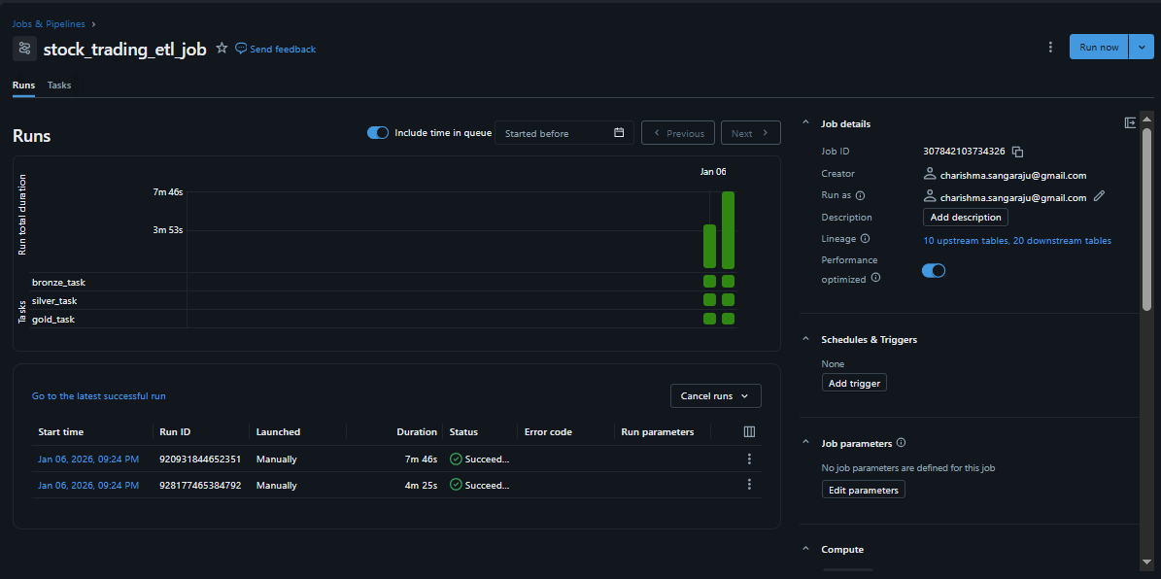
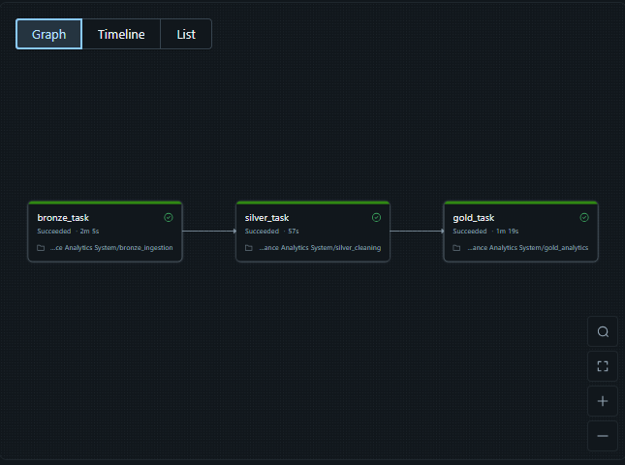
Successful Jobrun in Databricks

Slide 15
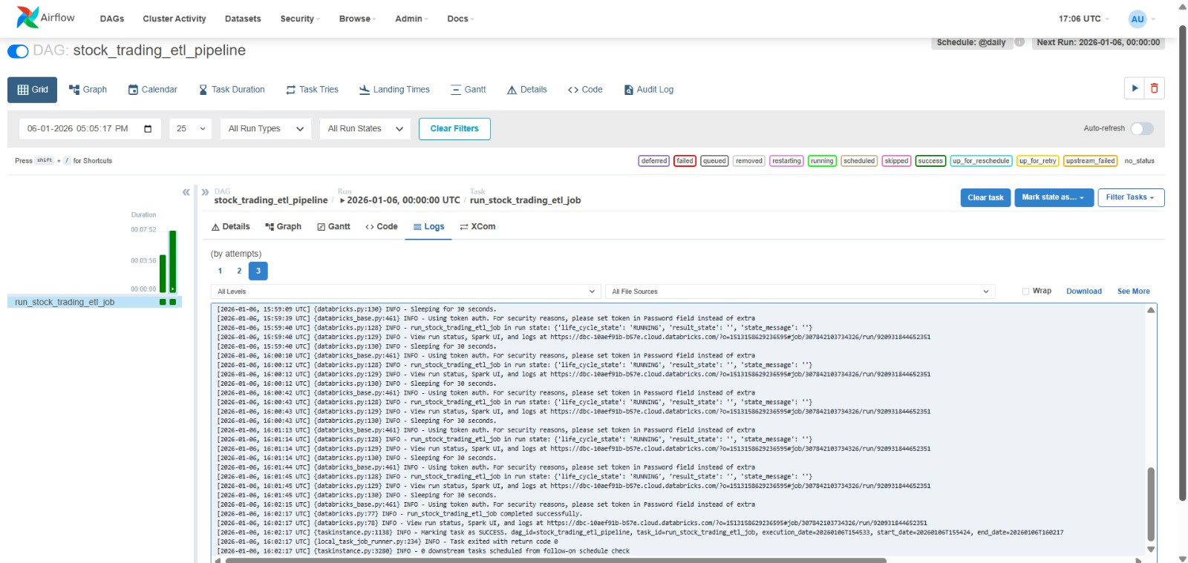
Logging & Monitoring

Slide 16
PowerBI Dashboards
Power BI is used to visualize insights from the Gold layer
Dashboards are built only on curated Gold tables
Provides an interactive and business-friendly analytics layer
Supports slicers, filters, and drill-downs for exploration
Dashboards Created
Executive Overview
Stock Performance & Risk Analytics
Market & Sector Overview
Portfolio & trading
Key Features
Date-based filtering using a DimDate table
KPI cards, line charts, bar charts, tables, and matrices

Slide 17
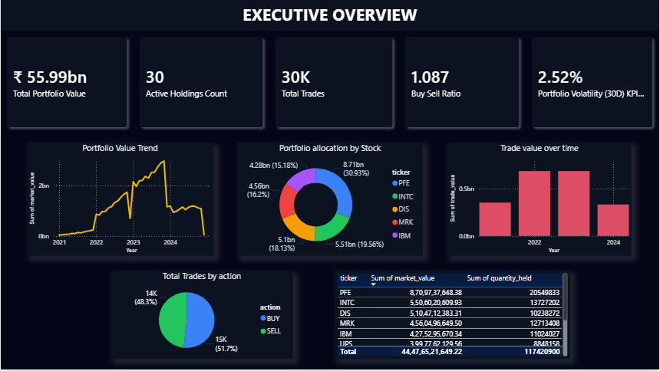
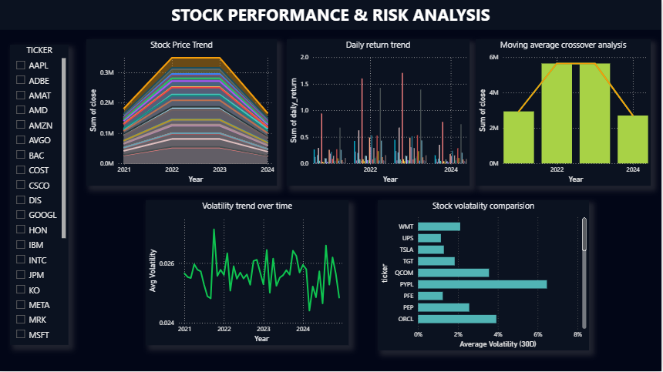
PowerBI Dashboards

Slide 18
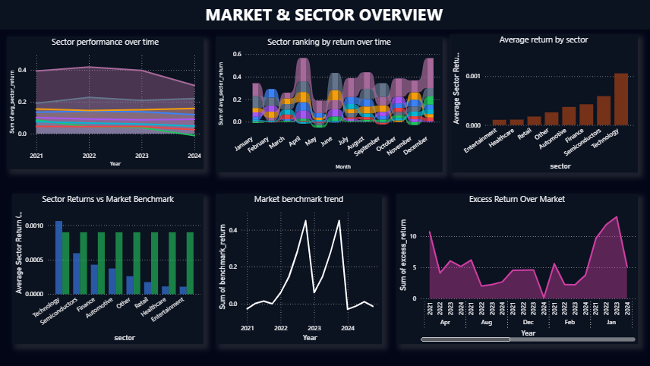
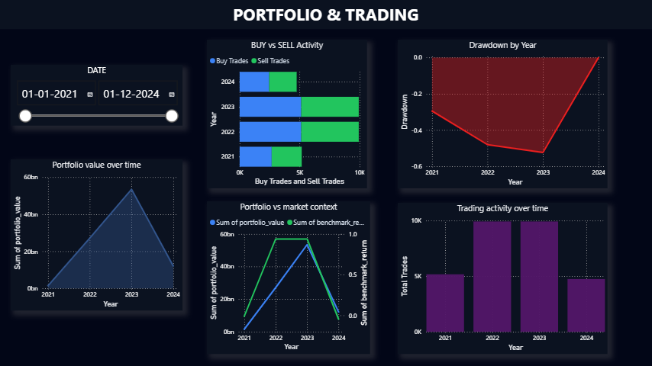
PowerBI Dashboards

Slide 19
Key Insights
Strong Portfolio Growth with Volatility
The portfolio experienced significant growth phases, especially during bullish market periods, but also showed sharp corrections—highlighting exposure to market volatility.
Active Trading Strategy
A high number of trades with a balanced BUY vs SELL ratio indicates frequent rebalancing and an active trading approach rather than passive investing.
Concentration Risk Identified
Portfolio allocation is skewed toward a few high-value stocks, making overall portfolio performance sensitive to movements in these holdings.
Sector Performance Variability
Technology and Financial sectors consistently outperformed others, while sectors like Entertainment and Healthcare showed relatively stable but lower returns.
Benchmark Comparison Reveals Mixed Performance
Certain periods show positive excess returns over the market benchmark, while others underperform—emphasizing the importance of timing and diversification.
Risk Indicators Highlight Volatile Stocks
Stocks with higher rolling volatility and frequent daily return spikes contribute disproportionately to portfolio risk.
Drawdowns During Market Downturns
Notable drawdowns were observed during market corrections, underscoring the need for stronger downside risk controls.

Slide 20
Conclusion & Future Scope
Conclusion
Successfully built an end-to-end Stock Trading & Investment Analytics System
Implemented a Bronze–Silver–Gold data architecture for reliable analytics
Automated data pipelines using Apache Airflow with Databricks jobs
Delivered interactive Power BI dashboards for portfolio, risk, sector, and benchmark analysis
Demonstrated real-world skills in data engineering, analytics, and visualization
Future Scope
Real-time data ingestion using APIs
Advanced risk metrics
ML-based forecasting for stock prices and portfolio optimization
Incremental & streaming pipelines using Delta Live Tables
Cloud deployment with Azure Data Factory and Power BI Service refresh

Slide 21
THANK YOU

